Slide 1
BotVac: Neato Vacuum Robot
ILHAMY ISYRAQ BIN AHMAD FADZIL (1812183)
IKHWAN BIN AMIR HAMZAH (1812423)
MOHAMMED SALEM AHMED BANAWAIR (1515875)

Slide 2
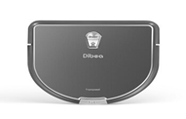
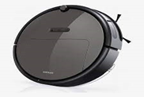
Robot Body Design vs Tasks
 | D-shaped | Round Shaped
Better in tight spot |  | ✓
Brush size | ✓
Cleaning efficiency | Better if the bot have easy access to move | Better if the place is crowded/tight spot
Aesthetics | ✓ | ✓

Slide 3
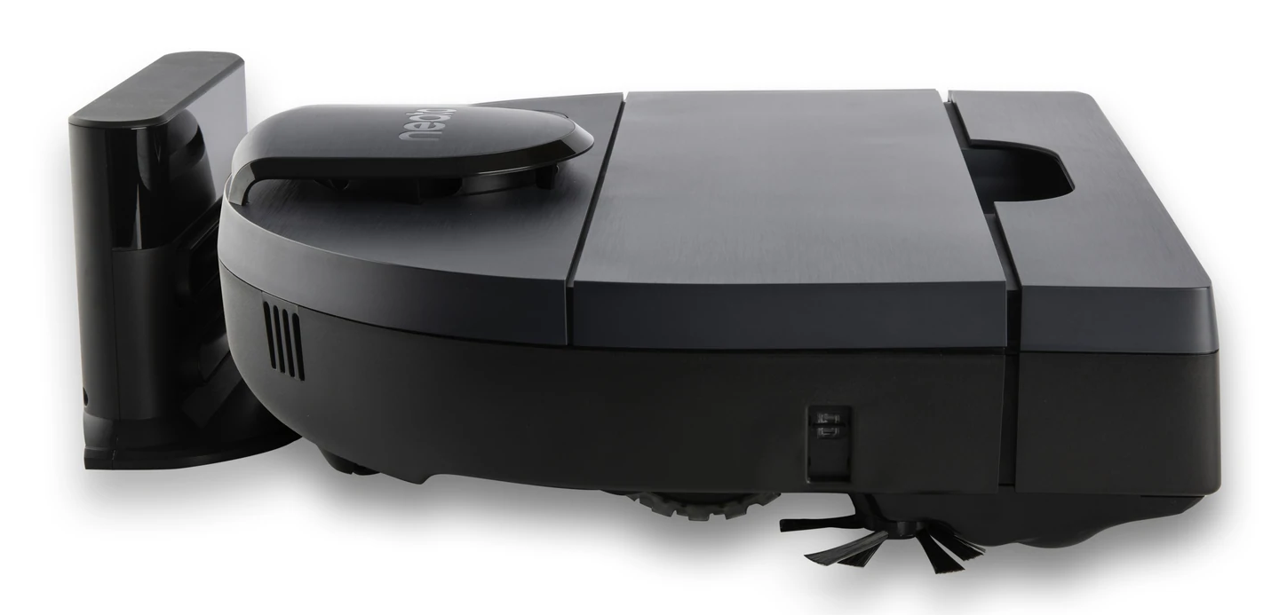
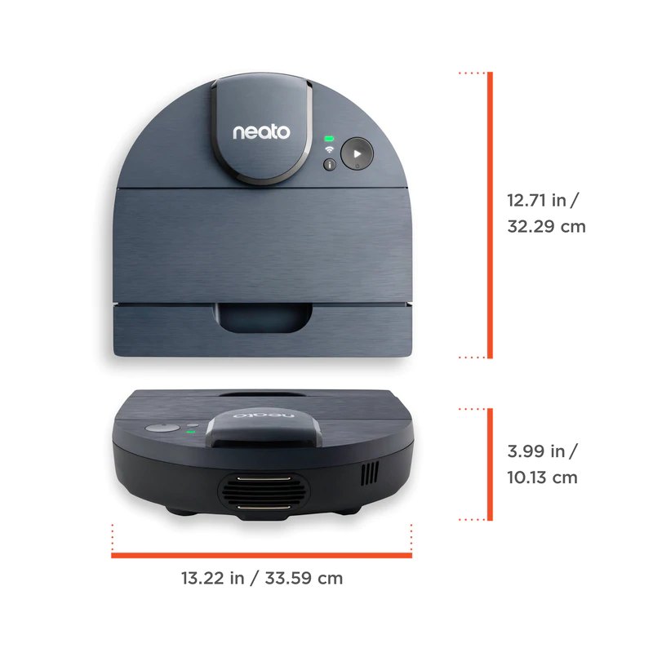
Robot Body Design
Material: ABS plastic

Slide 4
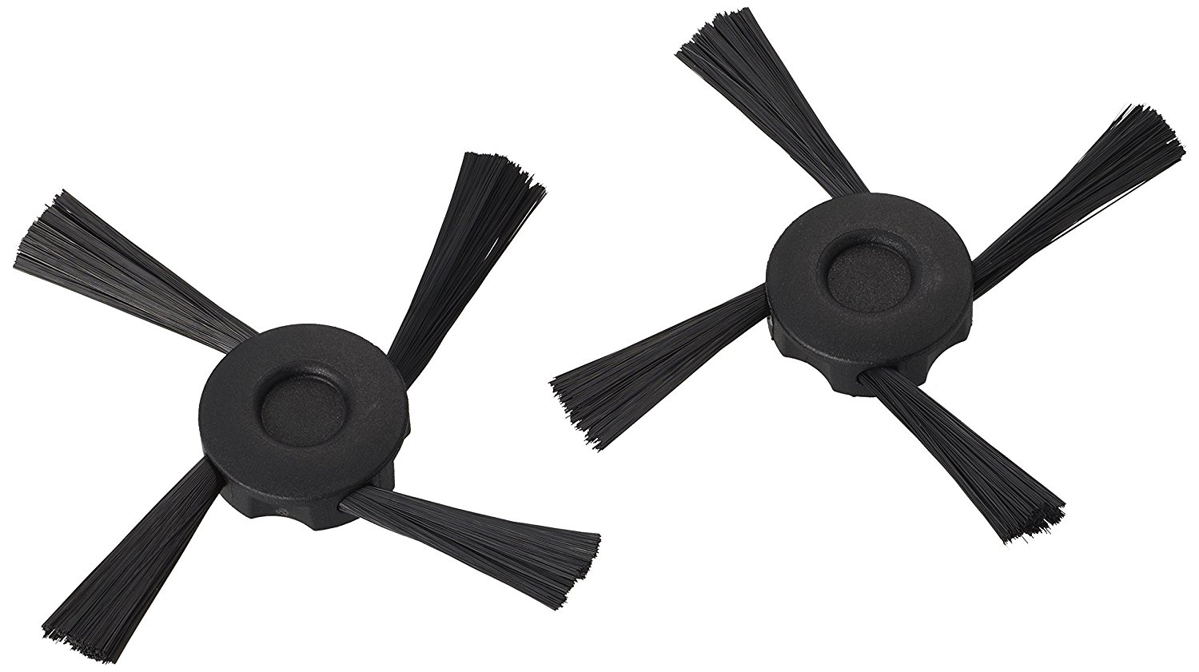
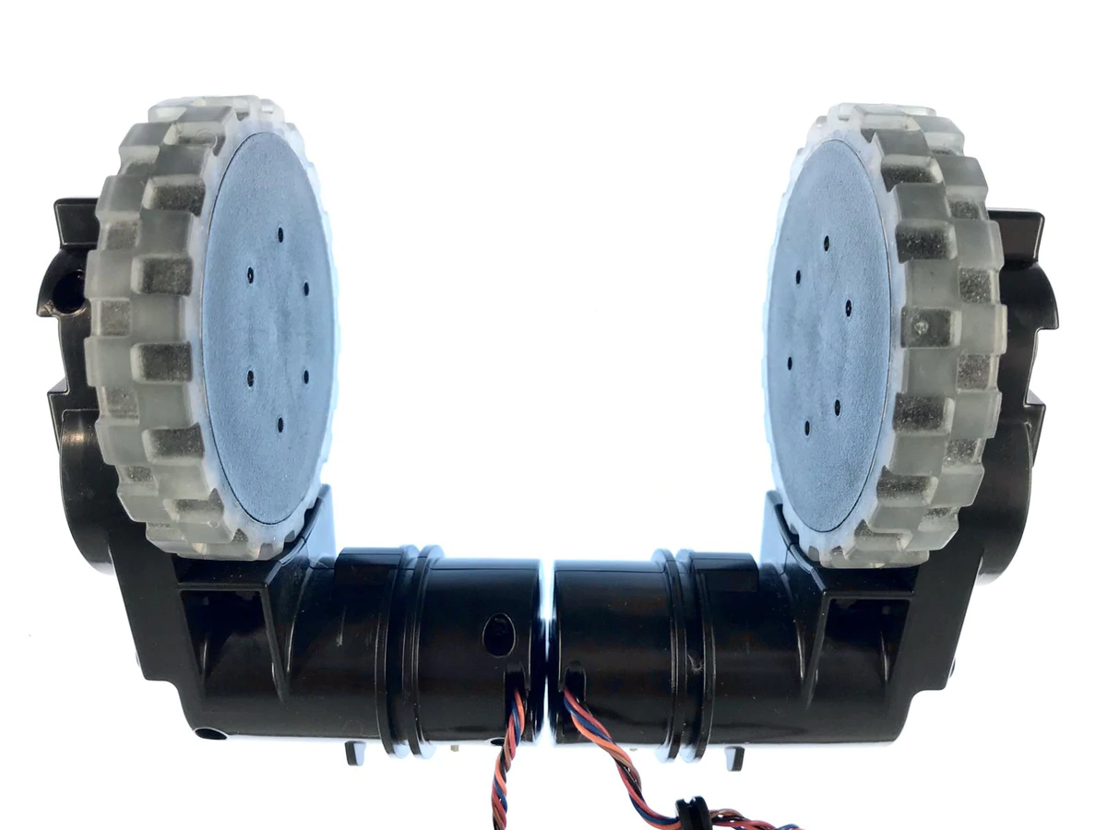
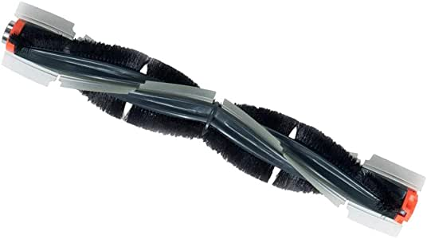
Actuators/Locomotion
2 drive motor
1 brush motor
1 vacuum blower
Wheel encoders to assist with telemetry
Wheel module set
Brush

Slide 5
Navigation System & Controller
Spinning Lidar sensor (newest model: D7, D8)
Laser distance sensor
Optical drop sensor
Optical proximity sensor
Hall effect sensor
Accelerometer
Bump switches
Wheel encoder
Custom navigation and control software based on Linux OS.
Limited API commands published for hobbyists.

Slide 6
Data Collection
Remember the maps that it makes—the maps are persistent between cleaning sessions (newest model)
Laser distance sensor for 2D point cloud navigation (smart laser guidance system concept)
Optical drop sensor to avoid cliffs
Optical proximity sensor for close wall following
Hall effect sensors for boundary marker detection
Accelerometer for tilt detection
Bump switches for obstacle detection

Slide 7
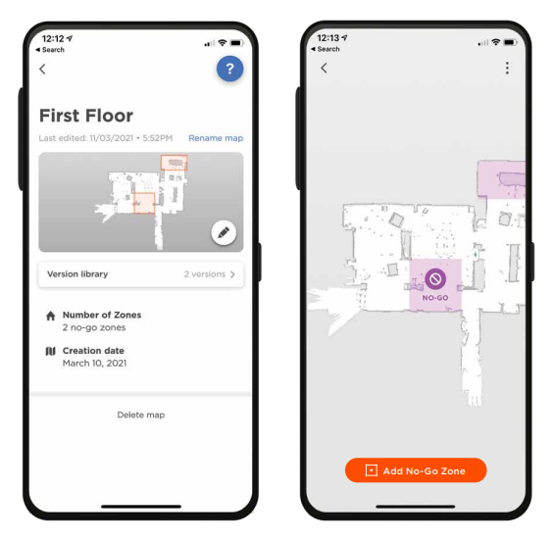
Data Transmission
WiFi (Apps)
Bluetooth ( ease for using wifi )
USB (Software update)
Neato Robotics (iOS & Android)

Slide 8
Power System Management
3200 mAh nickel-metal hydride batteries
Rechargeable
Voltage and current sensors to assist with charging and motor control

Slide 9
Thank you!

